Slide 1

“Advancing the Kingdom and Holding Ground”
Lessons for TCF from the Book of Joshua
Joshua 2:1-24
“Spying Out the Land” covert ops classified
By Sunny Daniels 20th July 2025

Slide 2


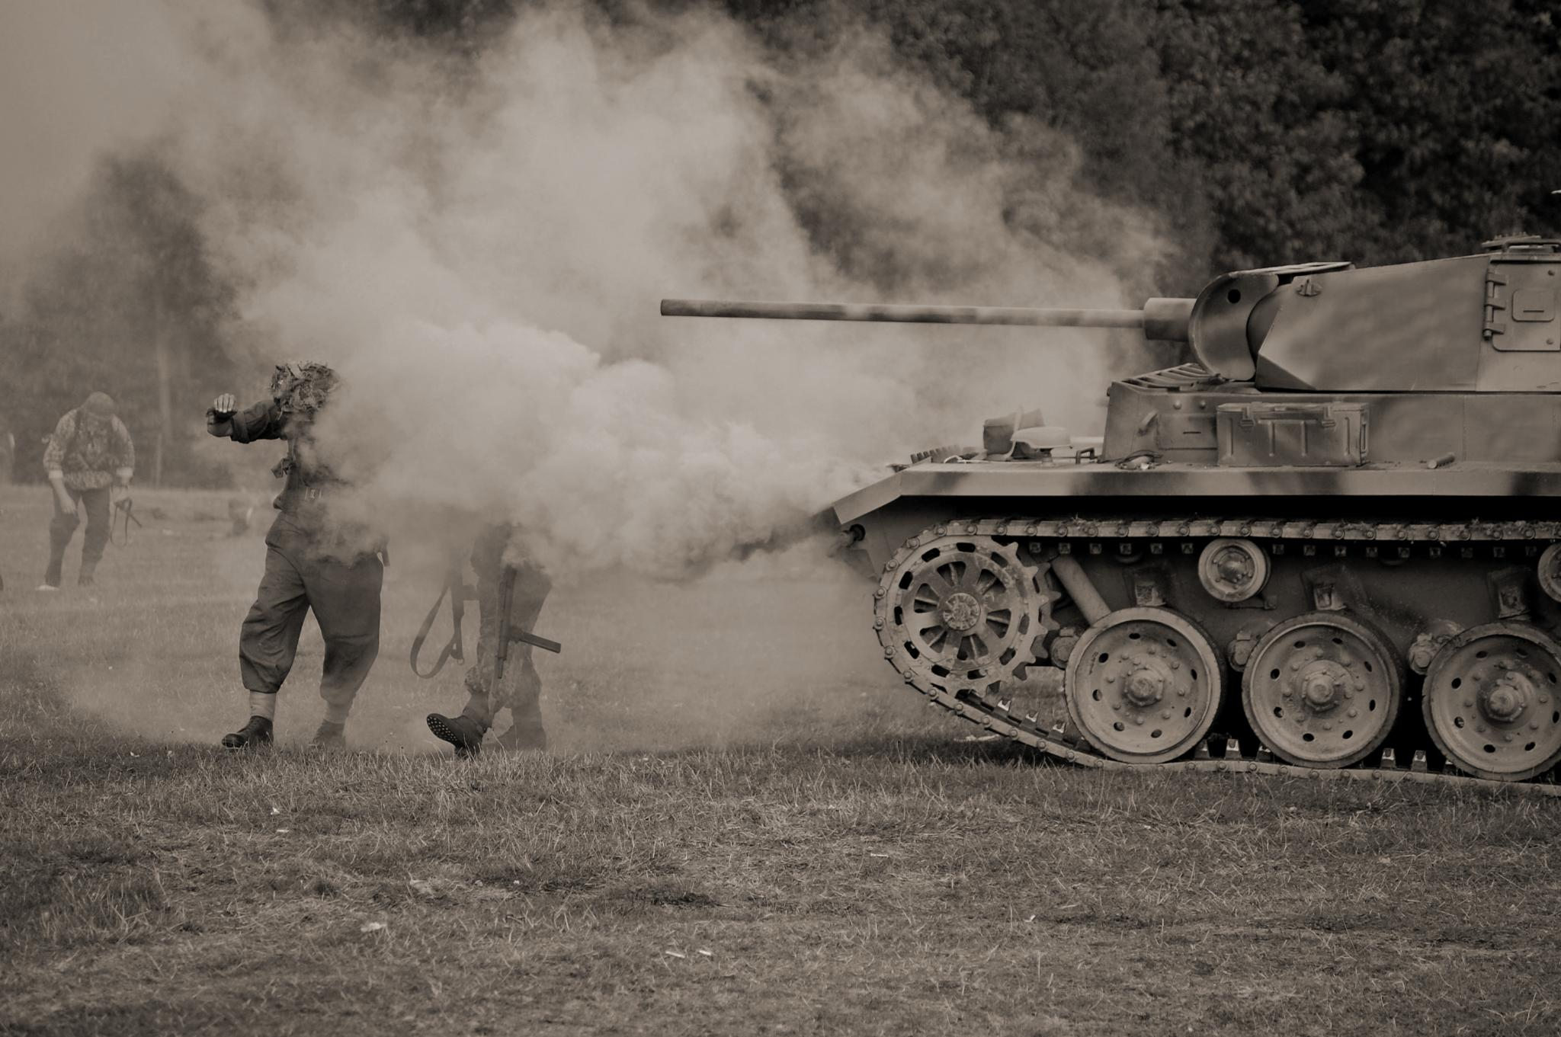
MOSES | JOSHUA
Led through 40 years of desert travel | Led through 30 years of conquering Cannan
Was a political and diplomatic leader | Was a military, in-your-face leader
Patiently listened to complaints | Confronted laziness and fear of the enemy
Led people as a peacemaking shepherd | Led people as a tough commander
Provided water from the rock when the people got thirsty | Told the people to dig their own wells when they got thirsty
Notes:
The words that sum up the Book of Joshua are ‘Warfare’ and ‘Inheritance’. We can learn about these things under the Old Covenant and then translate them into New Covenant language and practice. I will give an overview of these things and then individual Sunday preachers can drill down deeper into the secrets found in each chapter we cover.

Slide 3

Rules of Engagement 2 Tim 2:3-4
Be prepared. 2 Tim 2 : 21
Forgiveness. 2 Corinth 2:10 -11
I have got your back covered. Luke 22:31-32
Resist. 1 Peter 5:8-9
Fitness. Jude 20-25
Be proactive. 1 Thessalonians 2:18
Notes:
Change of leadership: Joshua 1:2 NIV. "Moses my servant is dead. Now then, you and all these people, get ready to cross the Jordan River into the land I am about to give to them - to the Israelites”.
The old leadership and geography of Egypt and the wilderness are now forgotten, and a brand-new vision is to be communicated to the people. The miraculous crossing of two different stretches of water marked each part of Israel’s journey: the Red Sea and the Jordan.
Jesus is introduced as the real Commander-in-Chief – as described in Joshua 5.

